Slide 1
Cefalee
«Caccia alla cefalea secondaria»
Dott. Andrea Zini
Direttore UOC Neurologia e Rete Stroke metropolitana
Ospedale Maggiore
IRCCS Istituto delle Scienze Neurologiche di Bologna
AUSL Bologna

Slide 2
IHS CLASSIFICATION
PRIMARY HEADACHES
1. MIGRAINE
2. TENSION HEADACHES
3. TRIGEMINAL AUTONOMIC CEPHALALGIAS
4. OTHER PRIMARY HEADACHES
SECONDARY HEADACHES
ICHD-3 beta Cephalalgia 2013;33:629.808

Slide 3
Cefalea = mal di testa
1) cefalea = sintomo
CEFALEE SECONDARIE
2) cefalea = malattia
CEFALEE PRIMARIE
.

Slide 4
attribuite a: trauma cranico e/o cervicale dist.vascolari cranio-cervicali dist.intracranici non vascolari uso/sospensione di sostanze infezione disturbi dell'omeostasi dist. cranio, collo, orecchi, naso, seni paranasali, denti, bocca e strutture facciali o craniche disturbo psichiatrico
Cefalea secondarie

Slide 5
Classification
Part 2: The secondary headaches
Headache attributed to trauma or injury to the head and/or neck
Headache attributed to cranial or cervical vascular disorder
Headache attributed to non-vascular intracranial disorder
Headache attributed to a substance or its withdrawal
Headache attributed to infection
Headache attributed to disorder of homoeostasis
Headache or facial pain attributed to disorder of the cranium, neck, eyes, ears, nose, sinuses, teeth, mouth or other facial or cervical structure
Headache attributed to psychiatric disorder
ICHD-3 beta Cephalalgia 2013;33:629.808
Notes:
5

Slide 6
Cefalea attribuita a trauma cranico e/o cervicale
Post-trauma cranico (acuta/cronica)‏
Dopo colpo di frusta (acuta/cronica)‏
Da ematoma intracranico traumatico
Da altri traumatismi cranici e/o cervicali
Post-craniotomia

Slide 7
Cefalea attribuita a disturbi vascolari cranici o cervicali
Ictus ischemico o TIA
Emorragia intracranica non traumatica
MAV non sanguinante
Arterite
A partenza da a.carotide o vertebrale
Da trombosi venosa cerebrale
Altro disturbo vascolare intracranico

Slide 8
Cefalea attribuita a disturbi intracranici non vascolari
Ipertensione liquorale
Ipotensione liquorale
Malattie infiammatorie non infettive
Neoplasia intracranica
Iniezione intratecale
Dopo crisi epilettica
Altre (malf. Chiari I, linfocitosi liquorale....)

Slide 9
Cefalea attribuita a infezione
Infezione intracranica (meningite e encefalite)
Infezioni sistemiche
HIV/AIDS
Cefalea cronica post-infettiva

Slide 10
Cefalea attribuita a disturbi dell'omeostasi
ipossia/ipercapnia
Elevata altitudine o immersione subacquea
Apnee da sonno
Ipertensione arteriosa
Ipotiroidismo
Digiuno
altre

Slide 11
Cefalea o dolori facciali attribuiti a disturbi di cranio, collo, occhi, orecchie, naso, seni paranasali, denti, bocca o strutture facciali o craniche
Cranio
Collo
Occhio (glaucoma)‏
Orecchio
Rinosinusiti
Denti, arcate, articolazione temporo-mandibolare

Slide 12
Cefalea attribuita a disturbo psichiatrico
Somatizzazione
Psicosi

Slide 13
Cefalee Primarie
Emicrania
a) senza aura
b) con aura
c) varianti
Cefalea di tipo tensivo
Cefalea a grappolo (Cluster Headache)‏
Altre cefalalgie (Hemicrania parossistica, Trigeminal Autonomic Cefalalgiae = TACs, Short-lasting Unilateral Neuralgiform headache attacks with Conjunctival injection and Tearing = SUNCT)‏
Cefalea da uso eccessivo di farmaci

Slide 14
Cefalea Acuta
La prima domanda da fare è:
Modalità di esordio
improvviso
gradualmente ingravescente

Slide 15
Caratteristiche della Cefalea
1) localizzazione del dolore
2) tipo di dolore
3) sintomi d’accompagnamento
4) durata degli episodi
5) frequenza
6) risposta a trattamenti
7) fattori scatenanti
8) familiarità

Slide 16
Diagnosi Differenziale
ANAMNESI e ESAME NEUROLOGICO sono di solito sufficienti a distinguere una Cefalea Secondaria da una Primaria, senza necessità di esami ematici o strumentali.
ESAMI (ematici, radiologici, Visite Specialistiche varie….) possono essere necessari in casi di cefalea secondaria (secondo la malattia di base) o in casi dubbi.

Slide 17
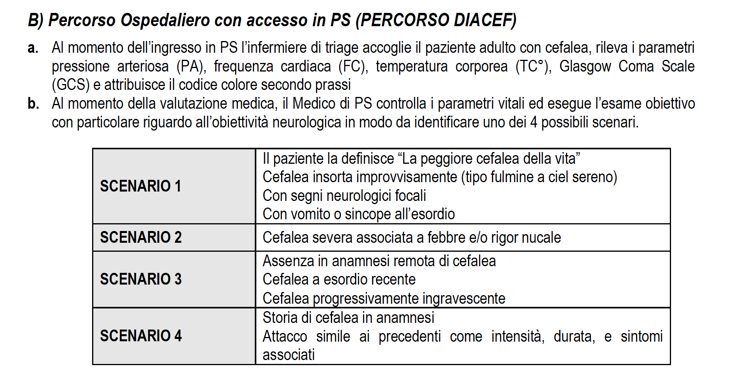
SCENARI

Slide 18
Non-sinister Secondary Headaches – The most common
Medication Overuse Headaches
Post-traumatic Headaches
Errors of Refraction
Sinus Related
(Hypertension)

Slide 19
SINISTER SECONDARY HEADACHES
Vascular
Thunderclap Headaches
Carotid or Vertebral Dissection
Giant Cell arteritis
Cerebral Venous Thrombosis
Non-vascular
Space Occupying Lesions
Infective
Meningitis and Encephalitis

Slide 20
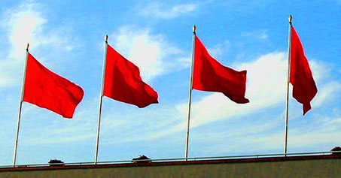
The Red Flags
Thunderclap headache
Recent onset and getting worse
Headaches precipitated by cough/valsalva manoeuvres
Headaches changing with posture
Onset > 50 yrs of age
Change in headache characteristic
HIV, Malignancy or risk factors for venous thrombosis
Focal neurological symptoms including visual complaints (not ‘aura’)

Slide 21
THUNDERCLAP HEADACHE
‘First or worst’ ever headache
As if you were hit at the back of the head with a cricket bat
If during sleep it wakes you up…
Peaks within 1 minute (up to 5 minutes)
Nausea, Vomiting, Sensitivity to light, sound and smell confuses you with Migraine

Slide 22
THUNDERCLAP HEADACHE
Common Causes
Sub-arachnoid haemorrhage
Reversible vasoconstriction syndrome.
Other IC haemorrhage
Venous Sinus Thrombosis
Pituitary Apoplexy
Arterial Dissection
Uncommon Causes
Meningitis
Temporal arteritis
CSF hypotension
Cerebellar infarct
Cerebral angiitis
Worst ever HA – Normal Exam – 12%
Worst ever HA – Abnormal Exam – 25%

Slide 23
RECENT AND PROGRESSIVE HEADACHES weeks to < 3/12
THE WORRY IS
Is it a tumour? Any age
Is it a blood clot in veins? Young females
Is there inflammation of vessels? Those above 50
Is there a rise in fluid/pressure? Overweight
Is there a clot outside brain? Elderly with falls

Slide 24
HEADACHES PRECIPITATED WITH ANY VALSALVA MANOUVRES
This indicates a rise in pressure in the head on straining. So to exclude any space occupying lesion.
Remember migraine headaches are worsened on straining
Primary cough headaches / Primary exertional headaches are only precipitated doing the specific task

Slide 25
HEADACHES CHANGING WITH POSTURE
The intracranial pressure rises on lying and reduces on standing.
Normally there is autoregulation of intracranial pressure
If pressure is already high – it will increase more on lying down causing headache
If there is a leak of the CSF, the pressure drops more prominently on standing causing headache.

Slide 26
HEADACHES – NEW ONSET OVER AGE 50
Unless proved otherwise it indicates inflammation in blood vessels mainly temporal artery – TEMPORAL ARTERITIS
Serious as it could affect other blood vessels causing blindness, stroke etc
Majority feel very much unwell with loss of appetite, sleep, weight loss and tiredness.
Jaw pain while eating – pain on combing – tender temples
Majority will have an abnormal blood test
Steroids treat the condition dramatically

Slide 27
HEADACHES – A CHANGE IN CHARCTERISTIC
Being a migraineur does not protect you from anything else.
A change in character may mean a different cause.
Tendency to label every headache in migraineur as being migraine.
Describe what is different and insist on referral.

Slide 28
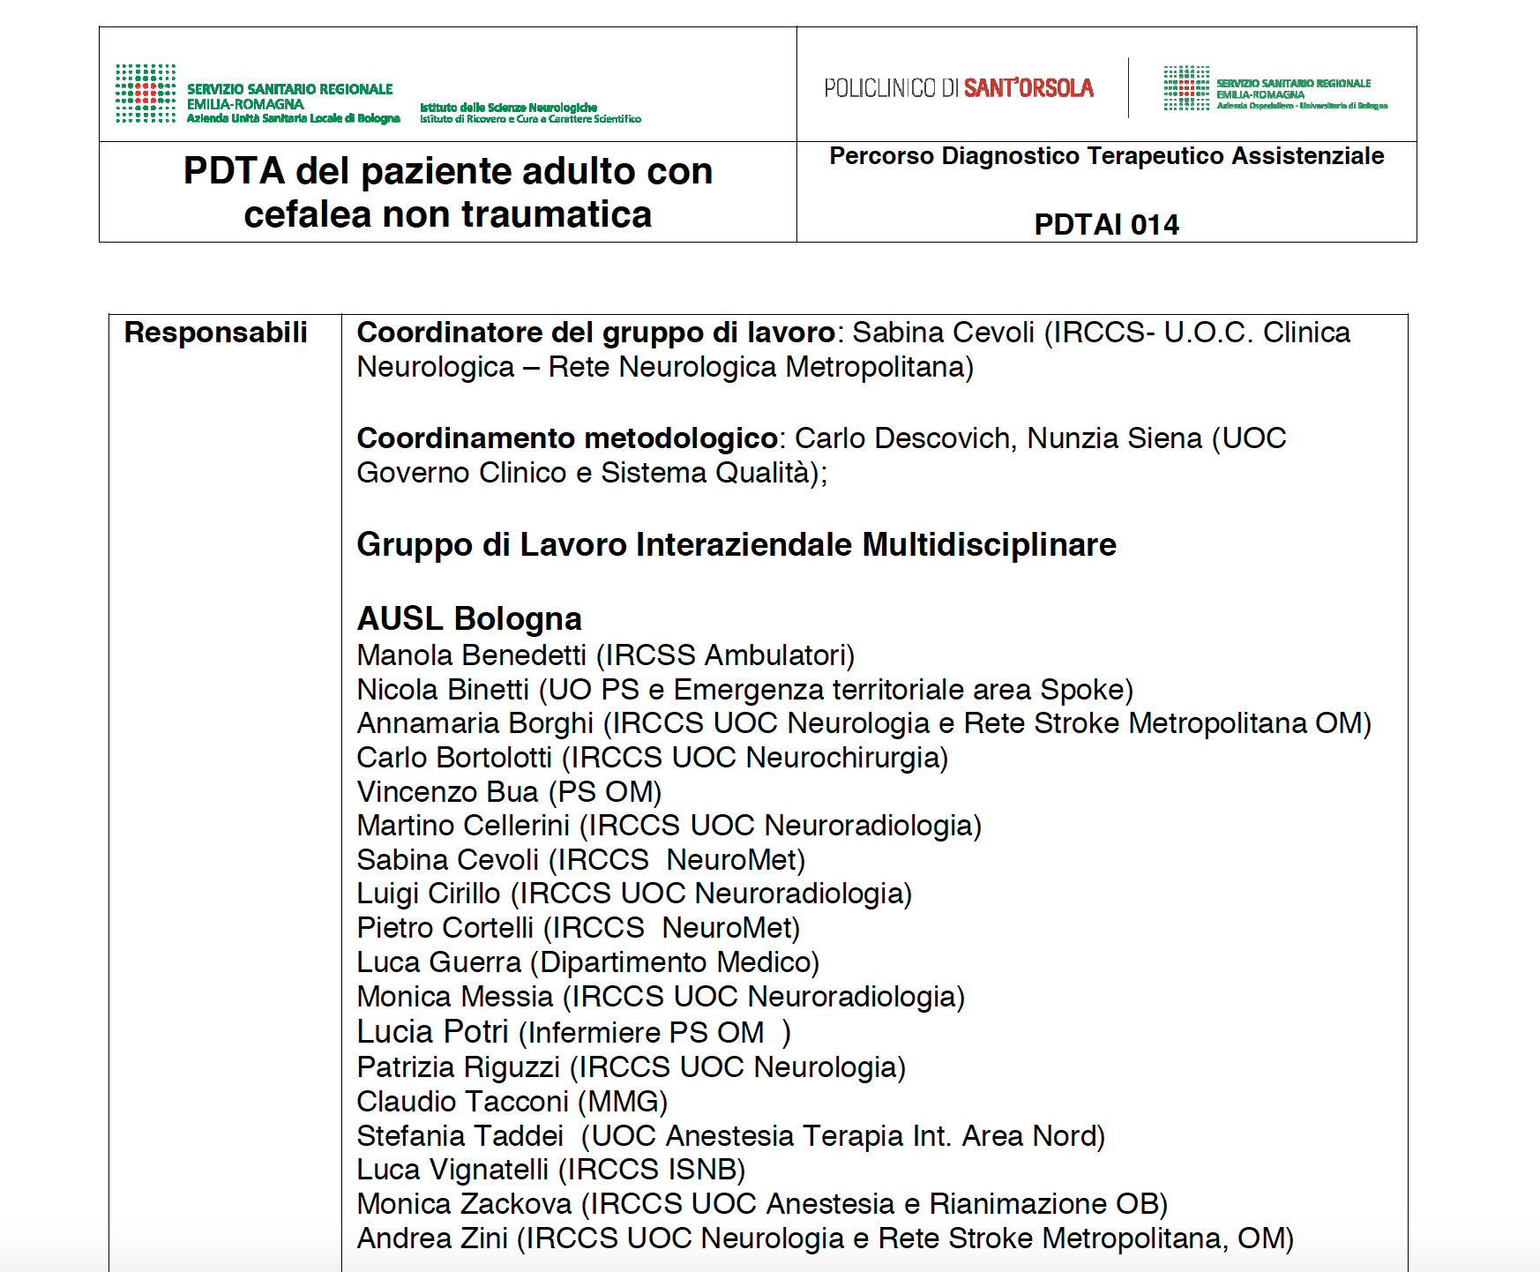

Slide 29
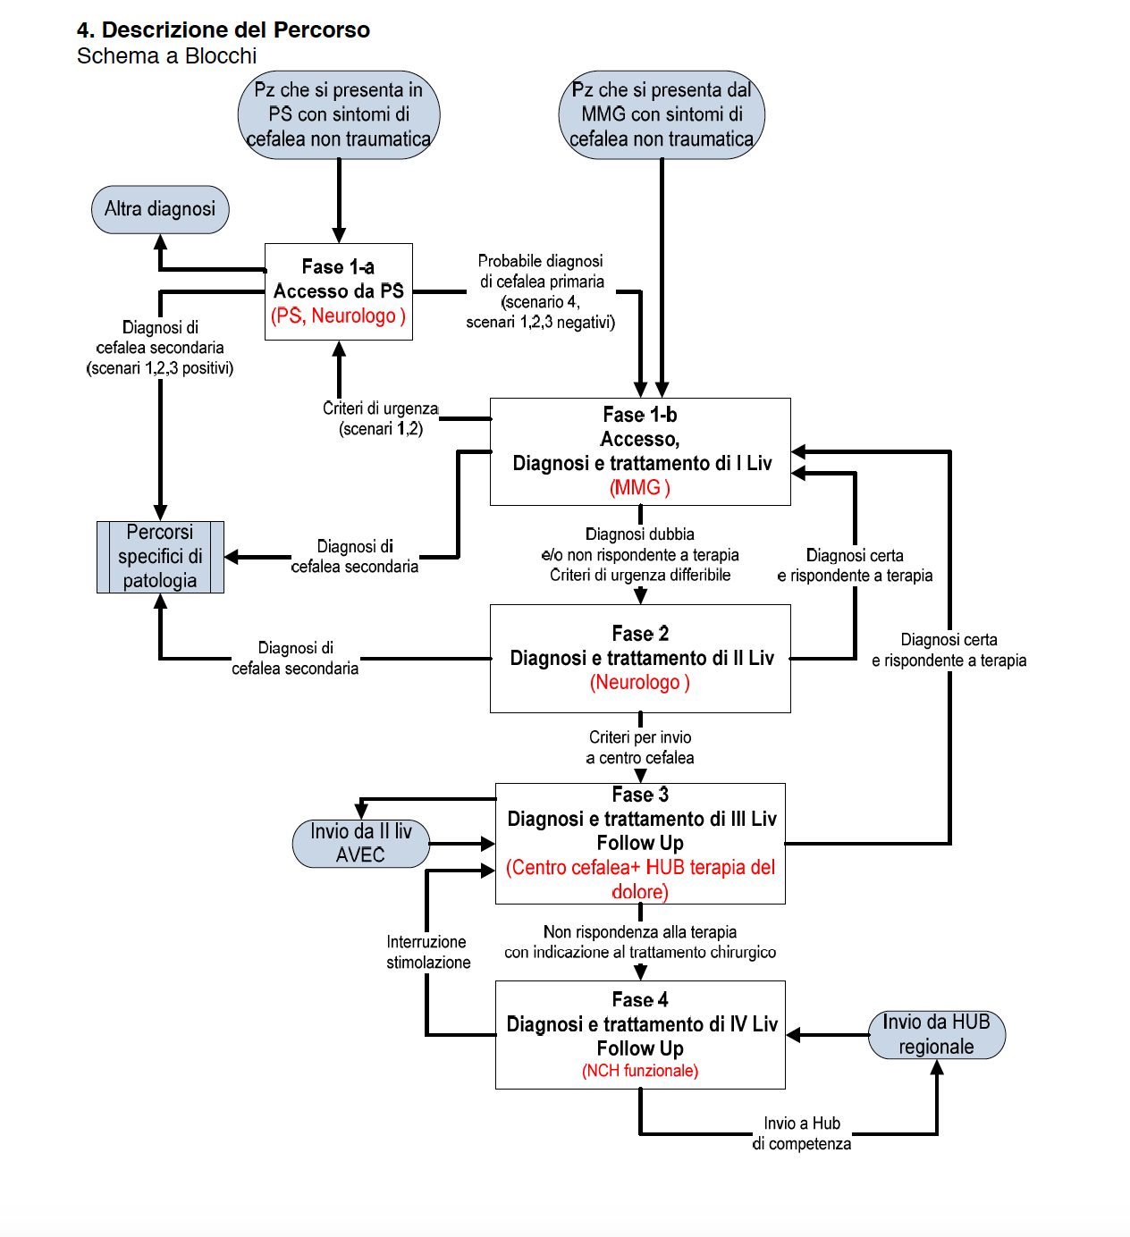

Slide 30
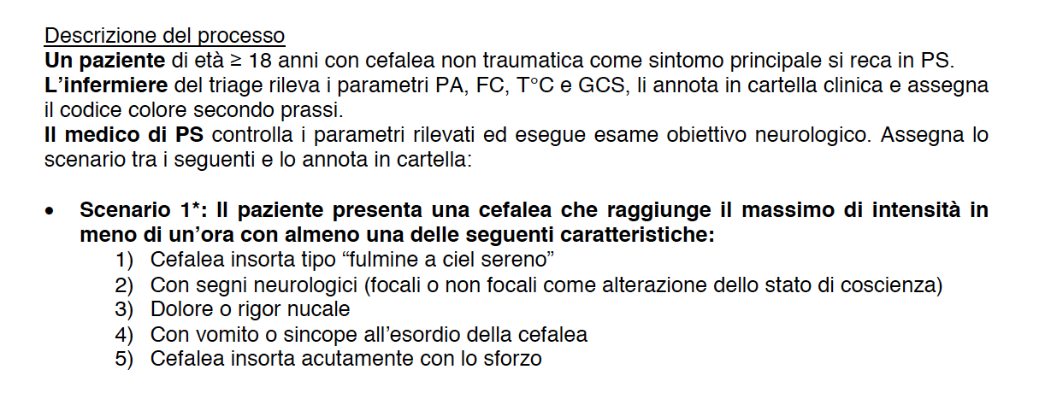

Slide 31
